Slide 1
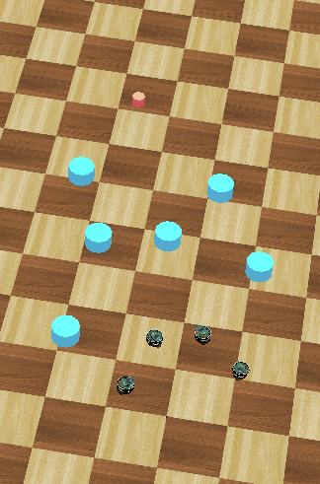
Distributed Intelligent Systems – Course Project
CSE - IN
Optimized Navigation Behaviour of Multiple Robots based on Motor-Schema
Students:
Ondine Chanon
Computational Science and
Engineering
Nicolas Hubacher
Computer Science
Stefano Savarè
Computational Science and
Engineering
Professor:
Alcherio Martinoli
Distributed Intelligent Systems
and Algorithms Laboratory
Assistant:
Zeynab Talebpour
Distributed Intelligent Systems
and Algorithms Laboratory
Ondine Chanon, Nicolas Hubacher, Stefano Savarè
December, 16th 2015

Slide 2
Introduction
Distributed Intelligent Systems – Course Project
2/18
Content
Introduction, goals and motivation
Motor-schemas based navigation behaviour
Particle Swarm Optimization (PSO)
Results
Conclusions
Ondine Chanon, Nicolas Hubacher, Stefano Savarè
December, 16th 2015

Slide 3
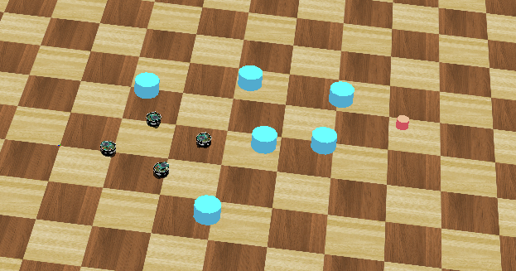
Introduction
Distributed Intelligent Systems – Course Project
3/18
Introduction, goals and motivation
Set-up
- 1 goal
- 4 robots
- some obstacles
Two-step project
- basic navigation control, based of 4 motor-schemas
- PSO implementation
Aim
- find the good balance between the objectives to get the best
possible behaviour
Ondine Chanon, Nicolas Hubacher, Stefano Savarè
December, 16th 2015

Slide 4
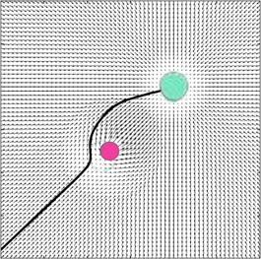
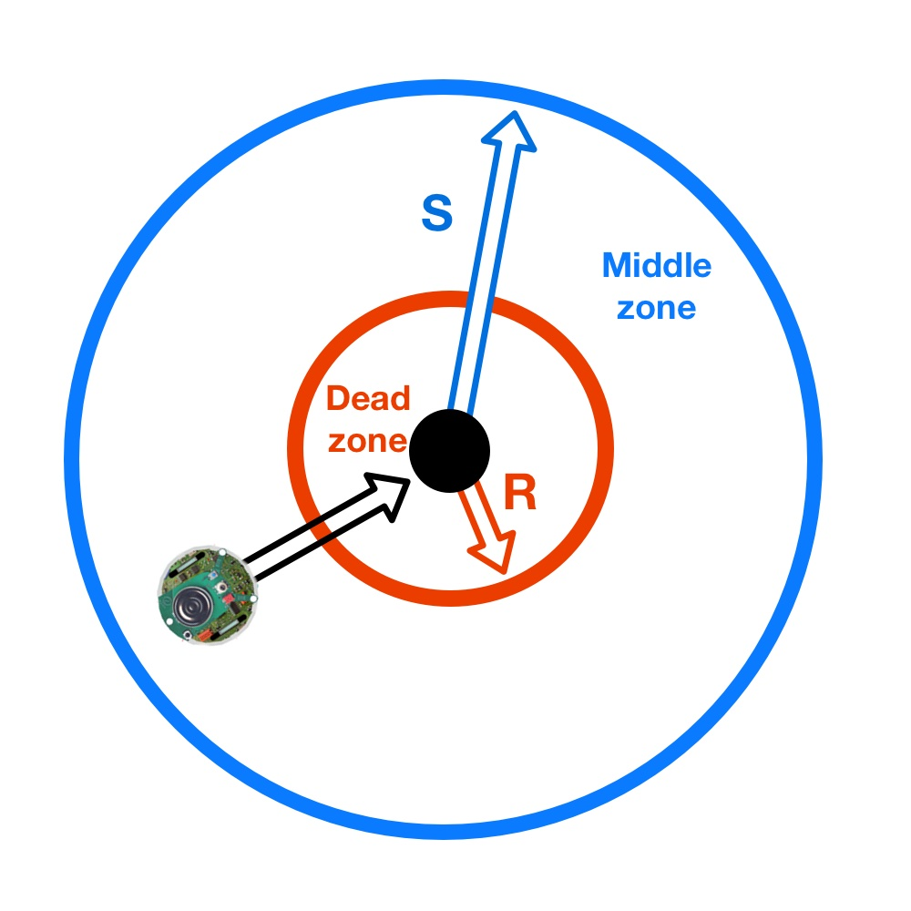
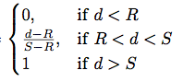
Introduction
Distributed Intelligent Systems – Course Project
4/18
Motor-schemas
General concept
Each motor-schema generates a vector
field
The global vector field is the sum of all the computed individual vector fields
Difficulty: presence of local minima
Sphere of influence
Most of the implemented motor-schemas use this concept
Example equation
Ondine Chanon, Nicolas Hubacher, Stefano Savarè
December, 16th 2015

Slide 5
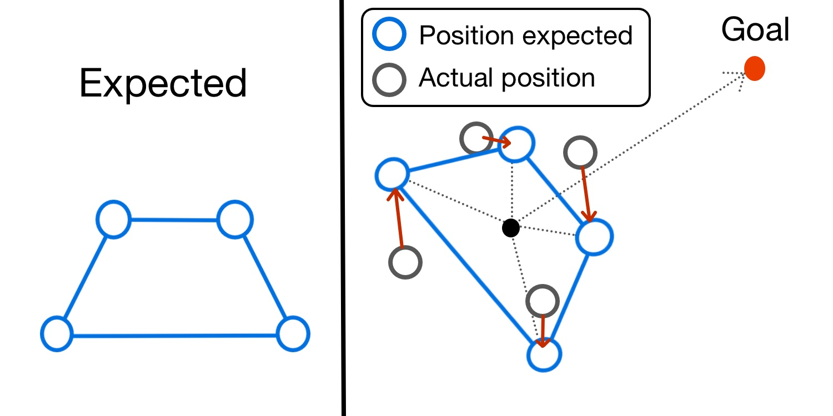
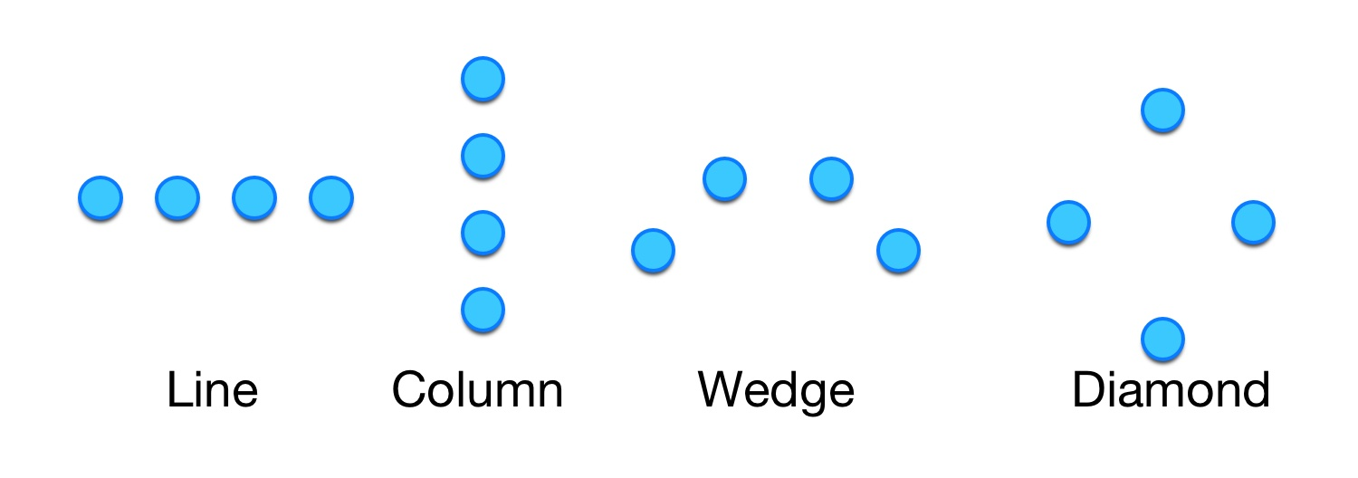
Introduction
Distributed Intelligent Systems – Course Project
5/18
Motor-schemas
Move to goal
Keep formation
- unit centered
Robot avoidance
- local communication
Obstacle avoidance
- supervisor
- distance sensors
Random walk
- noise generation frequency
- fading
Ondine Chanon, Nicolas Hubacher, Stefano Savarè
December, 16th 2015

Slide 6
Introduction
Distributed Intelligent Systems – Course Project
6/18
Particle Swarm Optimization
15 parameters to optimize:
- Weights for each motor-schema
- Minimum and maximum thresholds
- Parameters for random walk
Manual setting
Computationally expensive problem
‘Particle Space’: one dimension per parameter
- normalized dimension ranges
Problems with Webots ®
→ We have only optimized the motor-schema weights
Ondine Chanon, Nicolas Hubacher, Stefano Savarè
December, 16th 2015

Slide 7

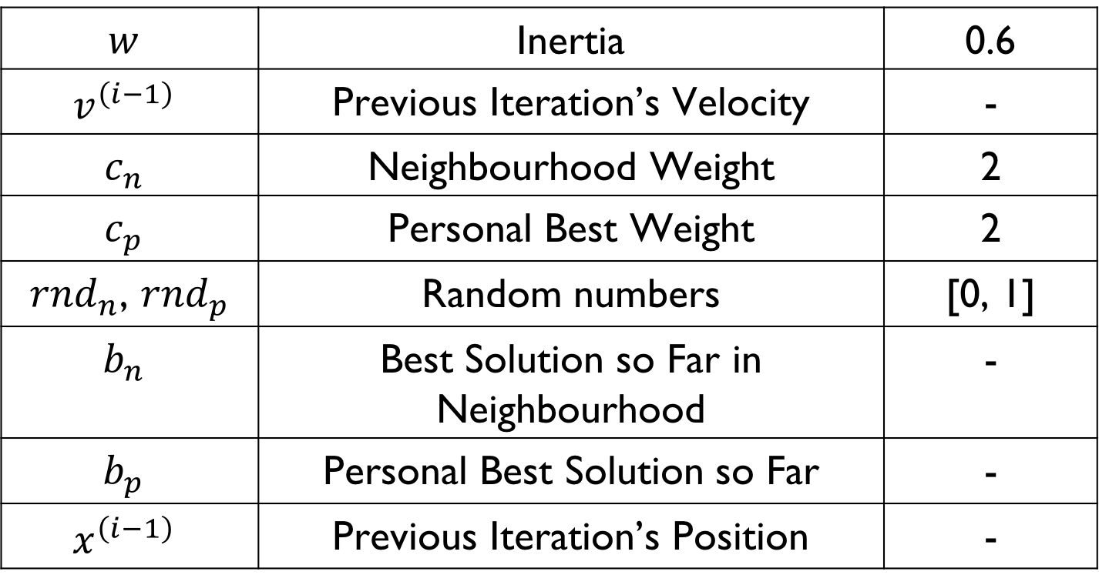
Introduction
Distributed Intelligent Systems – Course Project
7/18
PSO Formula
$v_{}^{(i)}=w⋅v^{\left(i−1\right)}$
$+c_{n}⋅{rnd}_{n}⋅\left(b_{n}−x^{\left(i−1\right)}\right)$
$+c_{p}⋅{rnd}_{p}⋅\left(b_{p} −x^{\left(i−1\right)}\right)$
$$w$$ | Inertia | 0.6
$$v^{\left(i−1\right)}$$ | Previous Iteration’s Velocity | -
$$c_{n}$$ | Neighbourhood Weight | 2
$$c_{p}$$ | Personal Best Weight | 2
${rnd}_{n}$, ${rnd}_{p}$ | Random numbers | [0, 1]
$$b_{n}$$ | Best Solution so Far in Neighbourhood | -
$$b_{p}$$ | Personal Best Solution so Far | -
$$x^{\left(i−1\right)}$$ | Previous Iteration’s Position | -
Ondine Chanon, Nicolas Hubacher, Stefano Savarè
December, 16th 2015

Slide 8
Introduction
Distributed Intelligent Systems – Course Project
8/18
PSO Parameters
Dimensionality | 4
Flock Size | 5
Neighbourhood Size | 2
Neighbourhood Type | ‘Ring’
Ranges | [0, 10]
Maximum Velocity | 1
Ondine Chanon, Nicolas Hubacher, Stefano Savarè
December, 16th 2015

Slide 9
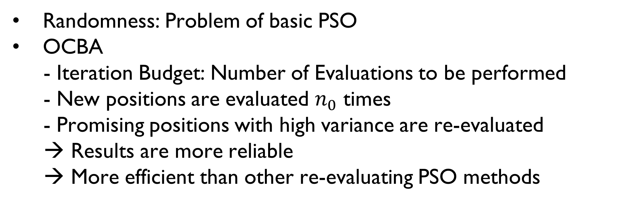

Introduction
Distributed Intelligent Systems – Course Project
9/18
Optimally Computing Budget Allocation (OCBA)
Randomness: Problem of basic PSO
OCBA
- Iteration Budget: Number of Evaluations to be performed
- New positions are evaluated $n_{0}$ times
- Promising positions with high variance are re-evaluated
→ Results are more reliable
→ More efficient than other re-evaluating PSO methods
Iteration Budget | 13
$$n_{0}$$ | 2
$$Δ$$ | 4
Ondine Chanon, Nicolas Hubacher, Stefano Savarè
December, 16th 2015

Slide 10
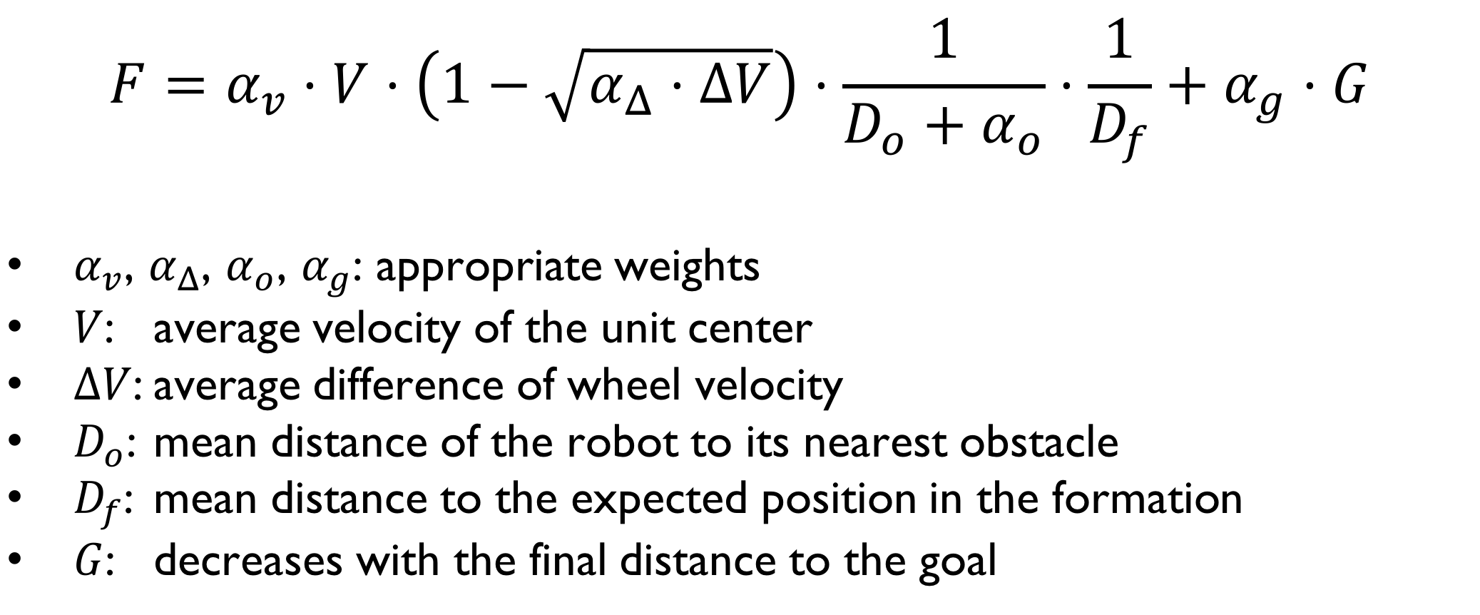
Introduction
Distributed Intelligent Systems – Course Project
10/18
Particle Swarm Optimization
$$F=α_{v}⋅V⋅\left(1−\sqrt{α_{Δ}⋅ΔV}\right)⋅\frac{1}{D_{o}+α_{o}}⋅\frac{1}{D_{f}}+α_{g}⋅G$$
$α_{v}$, $α_{Δ}$, $α_{o}$, $α_{g}$: appropriate weights
$V$: average velocity of the unit center
$ΔV$: average difference of wheel velocity
$D_{o}$: mean distance of the robot to its nearest obstacle
$D_{f}$: mean distance to the expected position in the formation
$G$: decreases with the final distance to the goal
Ondine Chanon, Nicolas Hubacher, Stefano Savarè
December, 16th 2015

Slide 11
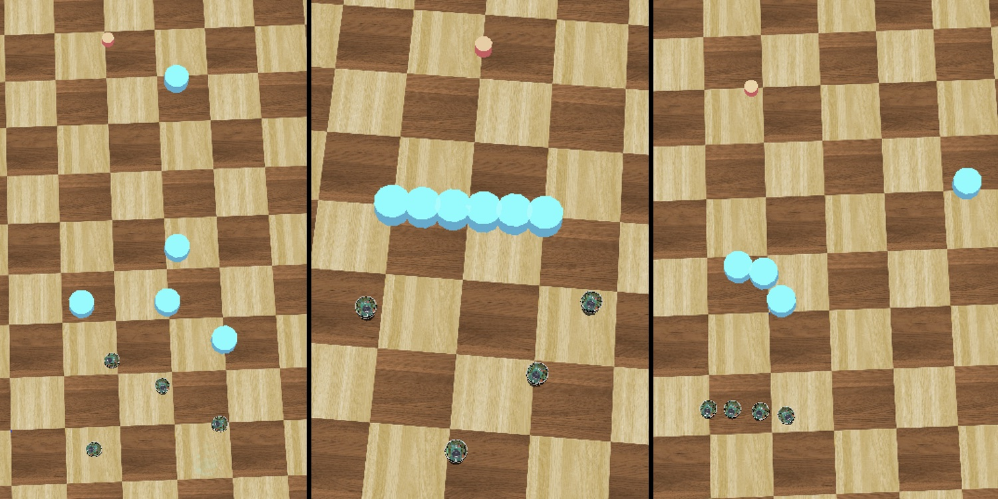
Introduction
Distributed Intelligent Systems – Course Project
11/18
Results
3 different worlds considered for PSO
1. Random
2. Wall of obstacles
3. Difficult configuration
Ondine Chanon, Nicolas Hubacher, Stefano Savarè
December, 16th 2015

Slide 12
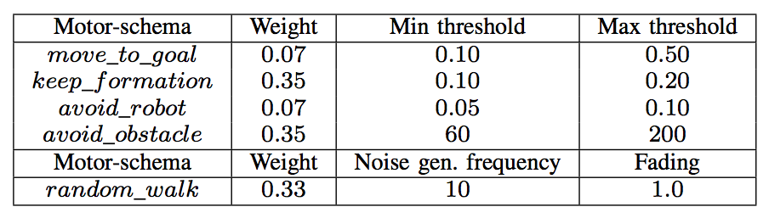
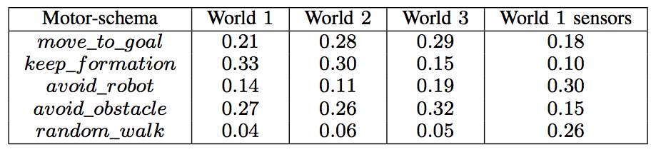
Introduction
Distributed Intelligent Systems – Course Project
12/18
Results
Parameters manually tuned
Weights found by PSO
Ondine Chanon, Nicolas Hubacher, Stefano Savarè
December, 16th 2015

Slide 13
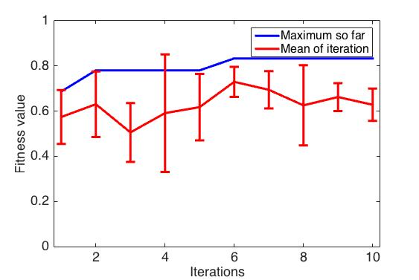
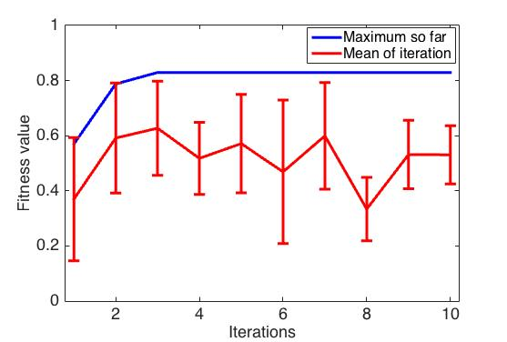
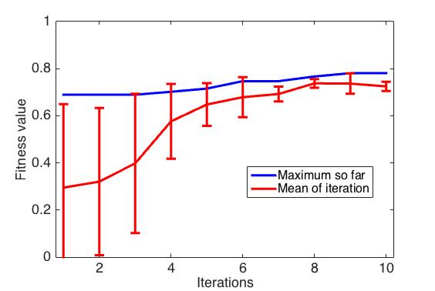
Introduction
Distributed Intelligent Systems – Course Project
13/18
Results
Random world
Wall world
Wedge formation; obstacles known through the supervisor
Better convergence: world with a difficult configuration
More iterations and more particles would be needed in the other 2 worlds to perform a better analysis
Difficult world
Ondine Chanon, Nicolas Hubacher, Stefano Savarè
December, 16th 2015

Slide 14
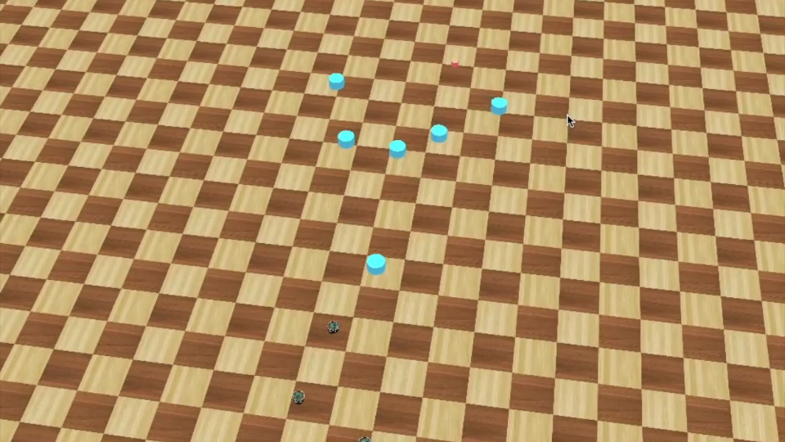
Introduction
Distributed Intelligent Systems – Course Project
14/18
Results
Different formations
Ondine Chanon, Nicolas Hubacher, Stefano Savarè
December, 16th 2015

Slide 15

Introduction
Distributed Intelligent Systems – Course Project
15/18
Results
PSO optimization
Ondine Chanon, Nicolas Hubacher, Stefano Savarè
December, 16th 2015

Slide 16
Introduction
Distributed Intelligent Systems – Course Project
16/18
Conclusions
Hand tuned parameters already provide a good controller
PSO – OCBA is a powerful tool: better results but higher simulation time
Unit-centered formation control is more robust to different formations than the leader referenced formation control
Formation does not have a big influence on PSO, but worlds do.
Noisy measures lead to suboptimal results: sensor measures and local communications
Further work:
- odometry based positioning
- computation of fitness metrics in the robot’s controllers
- combine PSO worlds
Ondine Chanon, Nicolas Hubacher, Stefano Savarè
December, 16th 2015
Notes:
Column formation have an higher probability to arrive faster to goal

Slide 17
Introduction
Distributed Intelligent Systems – Course Project
17/18
Bibliography
Arkin, Ronald C. Motor-schema based navigation for a mobile robot: An approach to programming by behavior. Robotics and Automation. Proceedings. IEEE International Conference on. Vol. 4. IEEE, 1987.
Balch, Tucker and Arkin. Behavior-based formation control for multi-robot teams. Robotics and Automation. IEEE Transactions on 14.6 (1998): 926-939.
Di Mario, Navarro and Martinoli. Analysis of fitness noise in particle swarm optimization: From robotic learning to benchmark functions. Evolutionaly Computation (CEC). IEEE Congress on. IEEE, 2014.
Eberhart, Kennedy. A New Optimizer Using Particle Swarm Theory. Sixth International Symposium on Micro Machine and Human Science. IEEE 1995.
Di Mario, Navarro and Martinoli. A Distributed Noise-Resistant Particle Swarm Optimization Algorithm for High-Dimensional Multi-Robot Learning. IEEE International Conference on Robotics and Automation. No. EPFL-CONF-206842, 2015.
Floreano and Mondada. Evolution of Homing Navigation in Real Mobile Robot Systems, Man and Cybernetics. Part B, IEEE Transactions on. Vol.26, Iss.3, Jun 1996, p.396-407.
Pugh, Zang and Martinoli. Particle swarm optimization for unsupervised robotic learning. Swarm Intelligence Symposium. No. SWIS-CONF-2005-004. 2005
Ondine Chanon, Nicolas Hubacher, Stefano Savarè
December, 16th 2015

Slide 18
Introduction
Distributed Intelligent Systems – Course Project
18/18
The end… almost !
Thank you for your attention
Questions?
Ondine Chanon, Nicolas Hubacher, Stefano Savarè
December, 16th 2015

Slide 19
Introduction
Distributed Intelligent Systems – Course Project
CSE - IN
Ondine Chanon, Nicolas Hubacher, Stefano Savarè
December, 16th 2015

